Slide 1
White-nose Syndrome & bat fertility
White-nose Syndrome & bat fertility
Presented by Kalee Elliott
JONATHAN MAYS, MAINE DEPARTMENT OF INLAND FISHERIES AND WILDLIFE

Slide 2
What is white-nose syndrome?

Slide 3
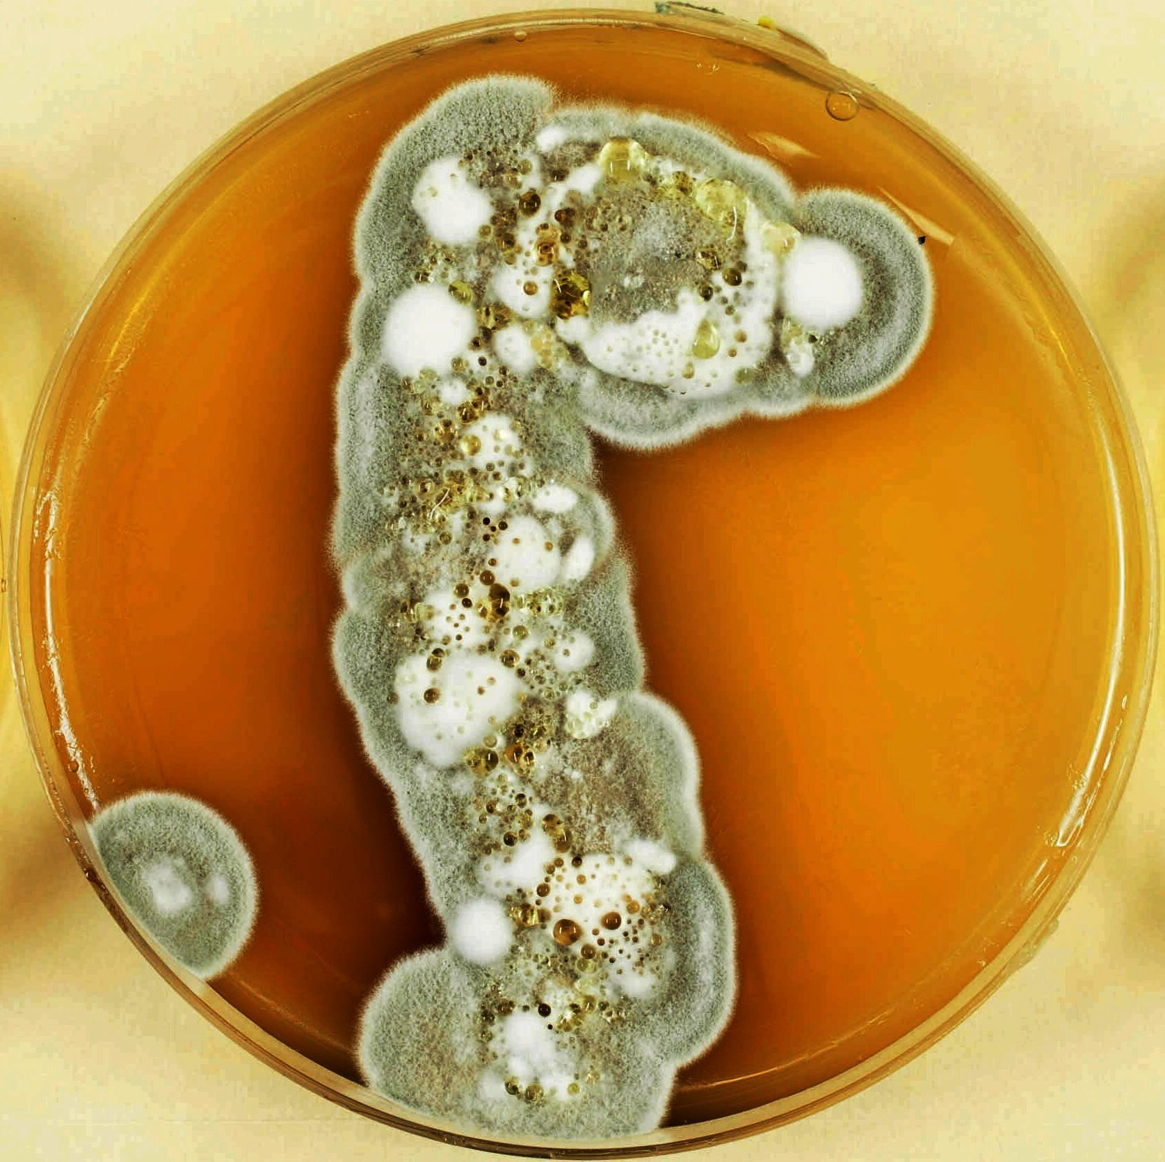
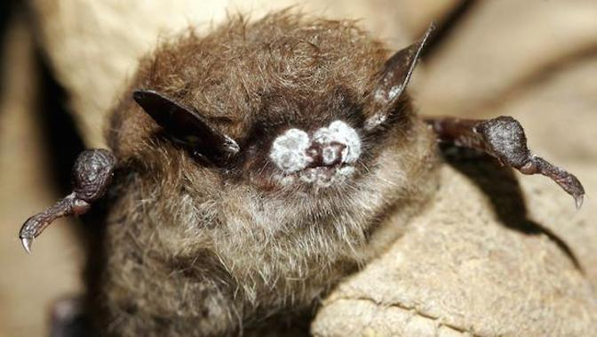
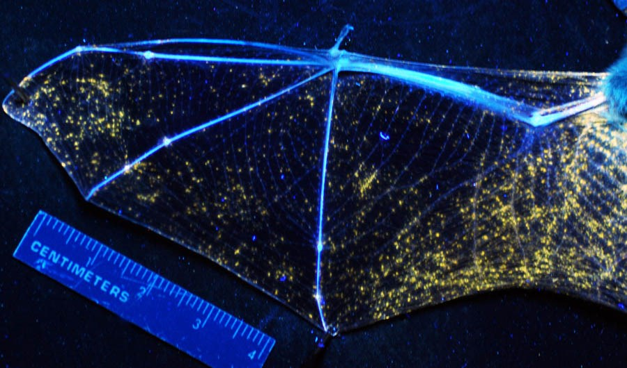
White-nose Syndrome (WNS)
Psychrophilic 4℃ to 20℃
Pseudogymnoascus destructans (Pd)
Myotis lucifugus (Little Brown Bat)
Notes:
Pseudogymnoascus destructans
Grows on the bats’ nose and wings
Psychrophilic
Affects bats during hibernation

Slide 4
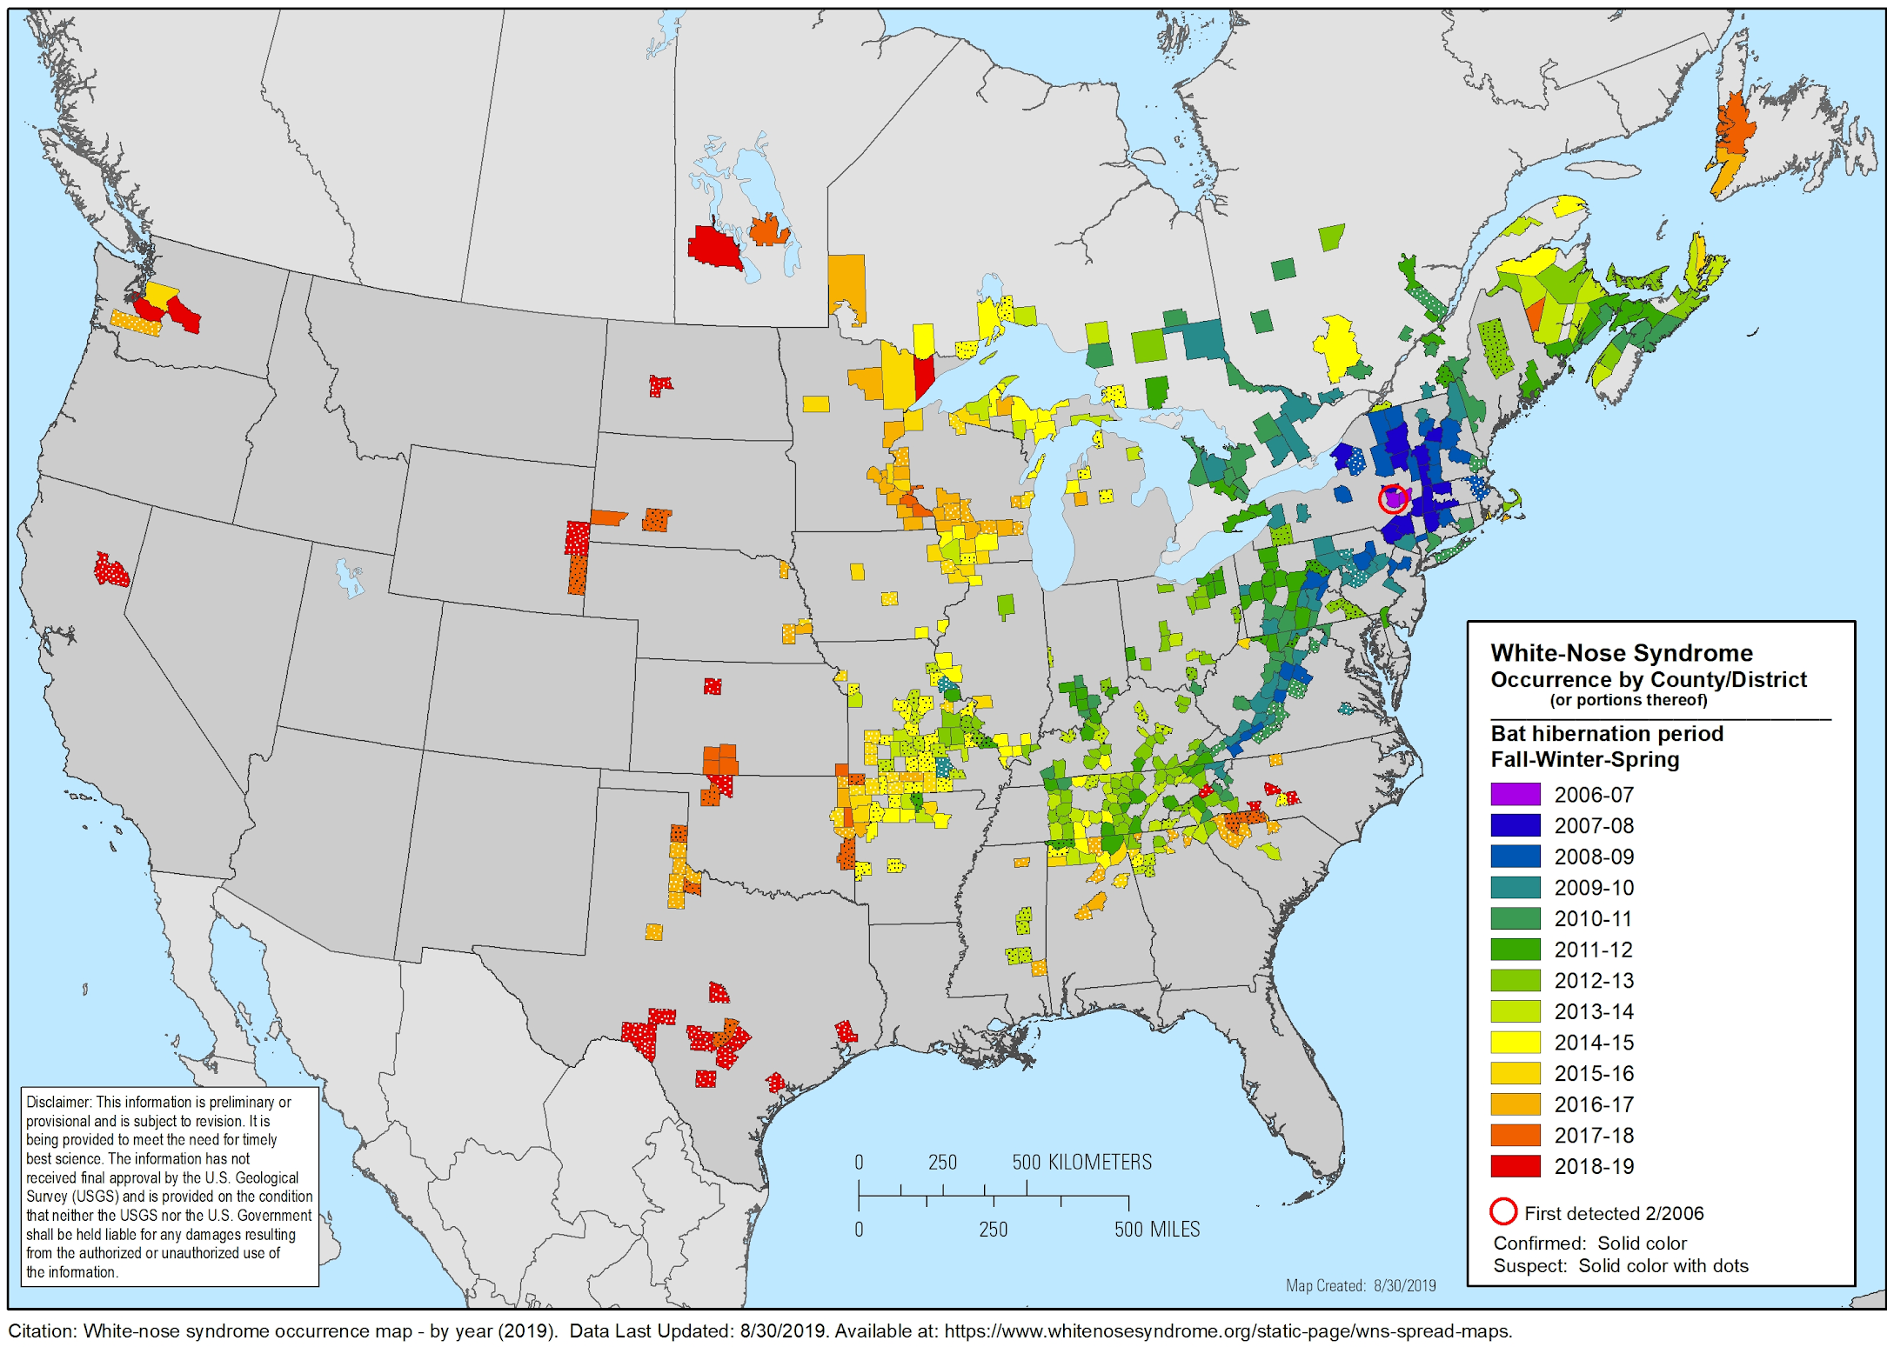
NY 2006
Where is WNS in the U.S.?

Slide 5
How does WNS affect bats?
Pd grows in a cave.
Pd grows in moist cold places such as caves.
Bat becomes overly active
Pd causes bats to become overly active and fly around during times they should be conserving fat for spring.
5 million and 7 million bats in the US and Canada have been wiped out; many species are now threatened or endangered. [1]
Mid-Winter
Spring
Fall
Late-Winter
Bat contracts WNS from Pd
Bats hibernate through the winter. They become topor and their body temperatures decrease. This allows the Pd to attack the bats skin and immune system.
The overactive bats die
Not all bats that contract Pd die; however, 90-100% of the bats that contract WNS do. This wipes out entire colonise.

Slide 6
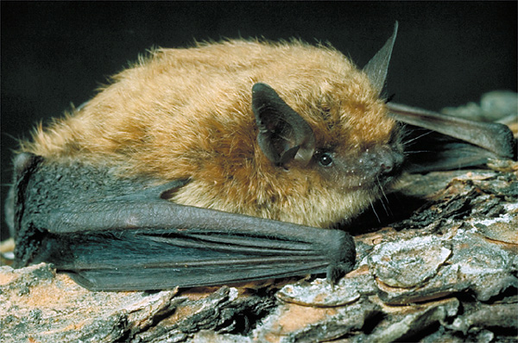
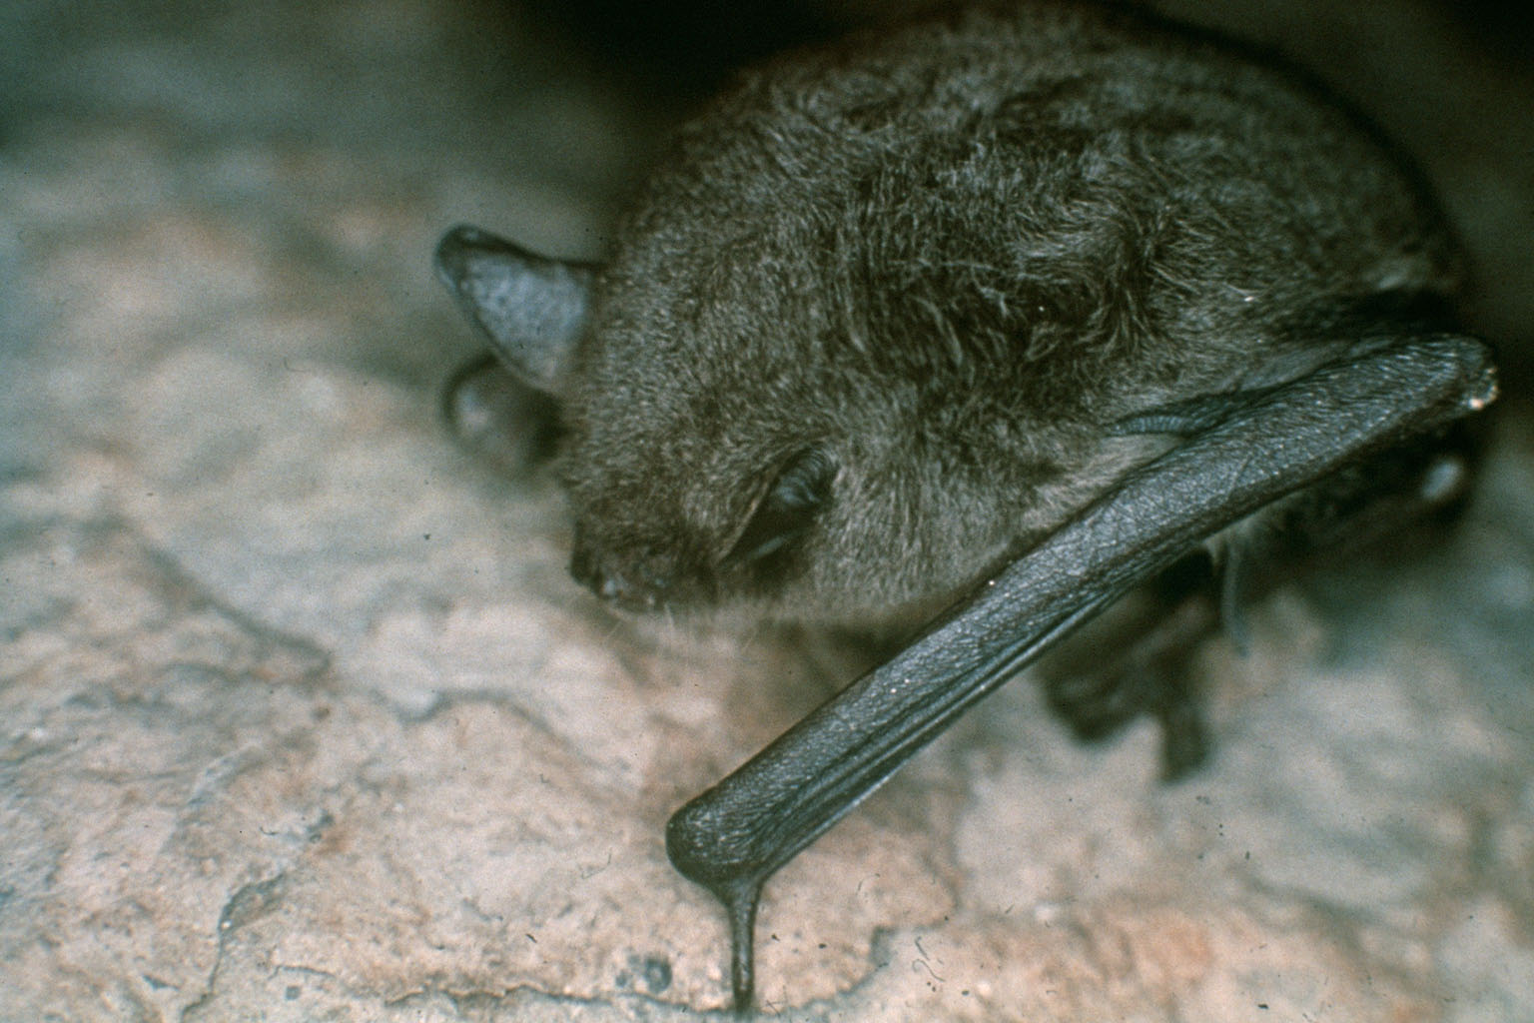
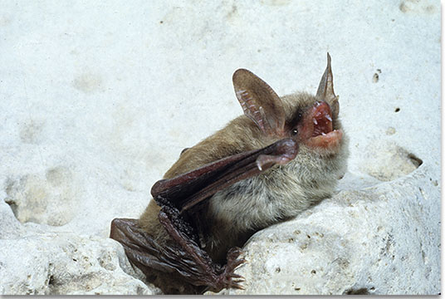
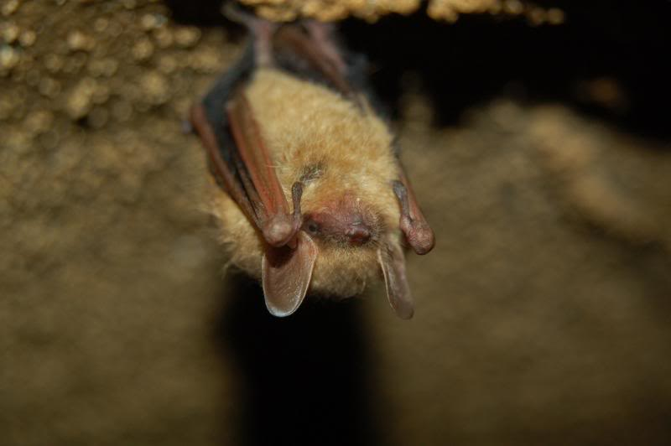
What bats are at risk in the U.S.?
Big brown bat (Eptesicus fuscus) Cave bat (Myotis velifer) Eastern small-footed bat (Myotis leibii) Fringed bat (Myotis thysanodes) Gray bat (Myotis grisescens) *endangered Indiana bat (Myotis sodalis) *endangered Little brown bat (Myotis lucifugus) Long-legged bat (Myotis volans) Northern long-eared bat (Myotis septentrionalis) *threatened Western long-eared bat (Myotis evotis) Tricolored bat (Perimyotis subflavus) Yuma bat (Myotis yumanensis)
Little brown bat (Myotis lucifugus)
Gray bat (Myotis grisescens)
Northern long-eared bat (Myotis septentrionalis)
Tricolored bat (Perimyotis subflavus)
*There are many more species that test positive for Pd but do not show signs of Pd.
** There are also species in Europe and Asia that test positive for Pd.

Slide 7
What has yet to be addressed?

Slide 8
Is there a cure?
How does WNS affect female bats?
Does is affect the next generation?
Researchers are working to try out many different techniques, so far these have been found to work most of the time:
UV light [2]
Probiotic bacteria [3]
Virally-vectored vaccine [4]
Female bats need to conserve a lot of fat during hibernation for when they get pregnant and give birth in the spring.
Thrifty Female Hypothesis [5]
There is currently not a lot of research into how WNS affects the next generation.

Slide 9
My question:
How does WNS affect the birth rate of populations?

Slide 10
The Experiment
STEP 1
STEP 2
STEP 3
STEP 4
Finding uninfected and infected populations then disinfect the infected population
Monitor both populations growth winter to spring
Test for pregnancies and monitor gestation
If WNS population is lower, determine how Pd has affected them.
Determine egg and sperm count of populations. Determine if ovulation is an issue. Determine if pregnancy is failing. Determine if live offspring are dying.
Oregon (U) + Washington (I) of M. lucifugus. UV light method because its easy, quick, inexpensive, and can be used on large areas. Wait one week and retest for WNS
Count n before disinfection, after, at the beginning of spring before pregnancies, and again after the offspring have been born.
Using a handheld and portable ultrasound device, bats that appear to be pregnant will be tested and monitored over 50-60 days.

Slide 11
Citations:
Bagniewska, J. (2018) White nose syndrome is killing millions of bats via a contagious fungus – here's how to stop it. The Conversation, https://theconversation.com/white-nose-syndrome-is-killing-millions-of-bats-via-a-contagious-fungus-heres-how-to-stop-it-91698
Palmer, J., Drees, K., Foster, J., & Linder, D. (2018) Extreme sensitivity to ultraviolet light in the fungal pathogen causing white-nose syndrome of bats. Nature Communications, 9:35. Doi: 10.1038/s41467-017-02441-z
Hoyt, J., et al. (2019) Field trial of a probiotic bacteria to protect bats from white-nose syndrome. Sci Reports, 9:9158. Doi: 10.1038/s41598-019-45453-z
Rocke, T., et al. (2019) Virally-vectored vaccine candidates against white-nose syndrome induce anti-fungal immune response in little brown bats (Myotis lucifugus). Sci Reports, 9:6788. Doi: 10.1038/s41598-019-43210-w
Jonasson, K. & Willis, C. (2011) Changes in Body Condition of Hibernating Bats Support the Thrifty Female Hypothesis and Predict Consequences for Populations with White-Nose Syndrome. PloS ONE, 6:e21061. Doi: 10.1371/journal.pone.0021061

Slide 12
Suggestions?

